Slide 1
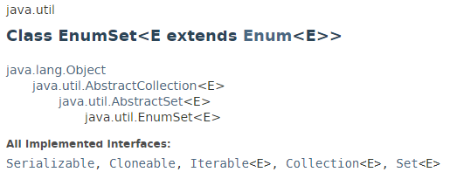
EnumSet
The java.util.EnumSet class is a specialized Set implementation for use with enum type.
All of the elements in an enum set must come from a single enum type that is specified, explicitly or implicitly, when the set is created.
Enum sets are represented internally as bit vectors.
EnumSet is not synchronized. If multiple threads access an enum set concurrently, and at least one of the threads modifies the set, it should be synchronized externally.

Slide 2
EnumSet
https://docs.oracle.com/javase/8/docs/api/index.html?java/util/EnumSet.html

